Slide 1
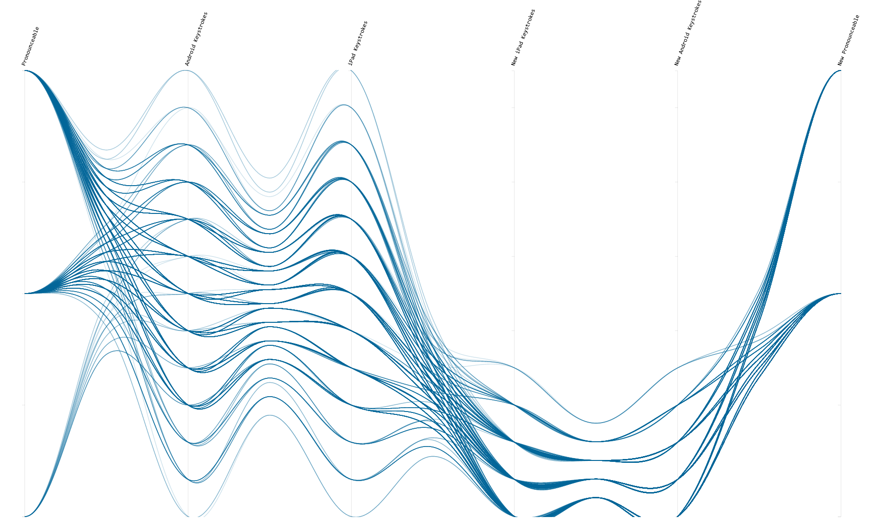
information VISUALIZATION
Cathryn Ploehn

Slide 2
What is visualization?
◕ ◡ ◕

Slide 3
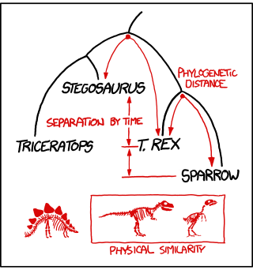

Slide 4
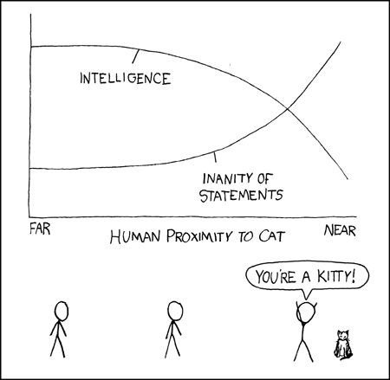

Slide 5
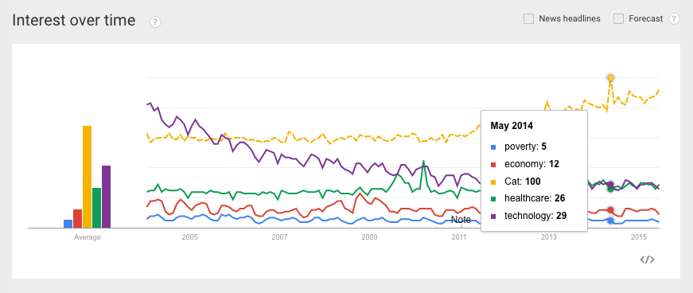

Slide 7
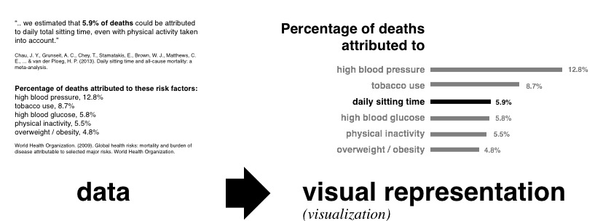

Slide 11
Visualization is a study of transformation from data to visual representations
“
Chen et al. 2014

Slide 12
Visualization is a study of transformation from data to visual representations in order to facilitate ↴
“
Chen et al. 2014

Slide 13
Visualization is a study of transformation from data to visual representations in order to facilitate ↴ effective and efficient cognitive processes in performing tasks involving data."
“
Chen et al. 2014

Slide 14
Visualizations facilitate effective and efficient cognitive processes

Slide 15
Visualizations facilitate performing tasks involving data

Slide 17
What is information visualization?
◕ o ◕

Slide 18
What is information visualization?
visual analytic tools for exploring and extracting patterns from abstract data.

Slide 19
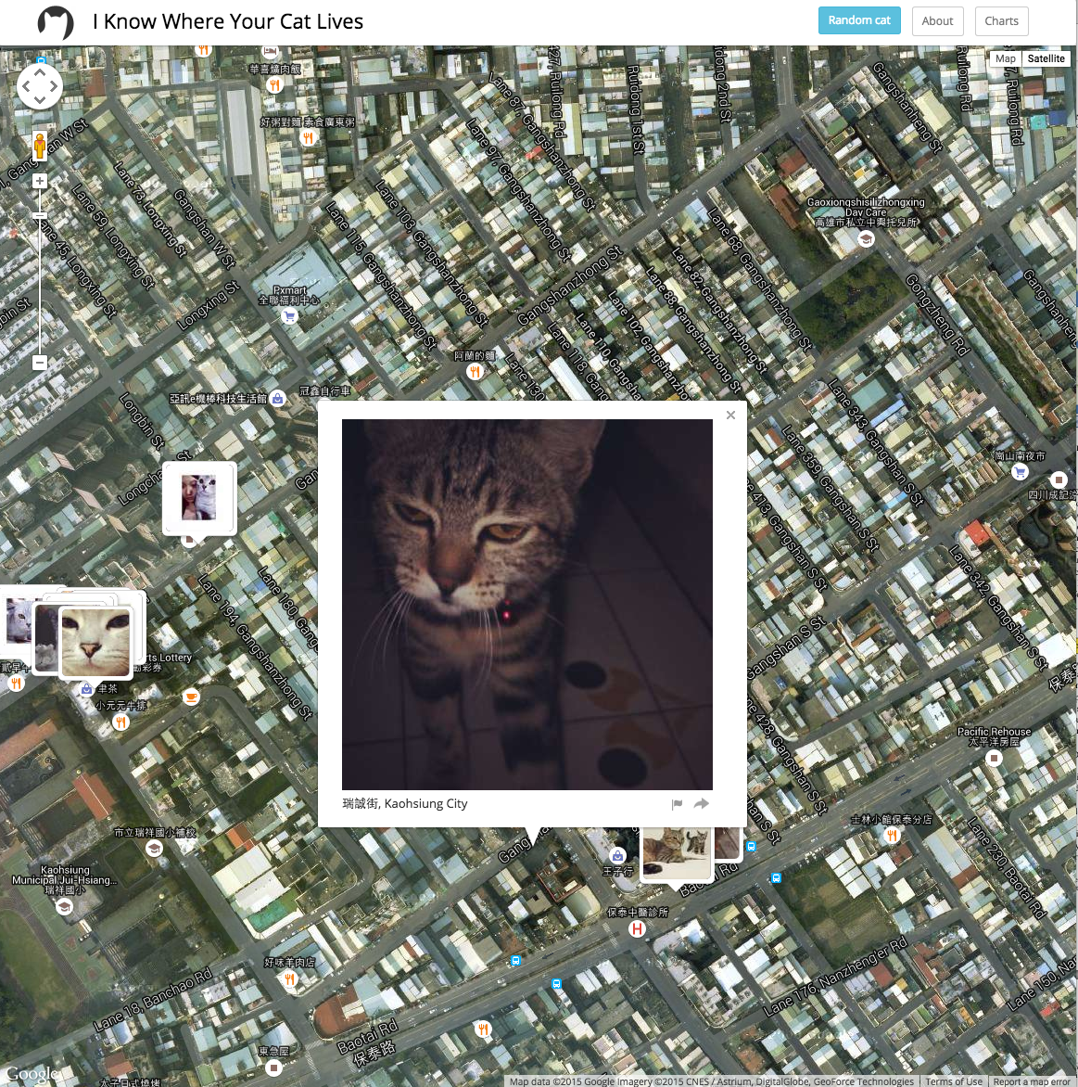

Slide 20
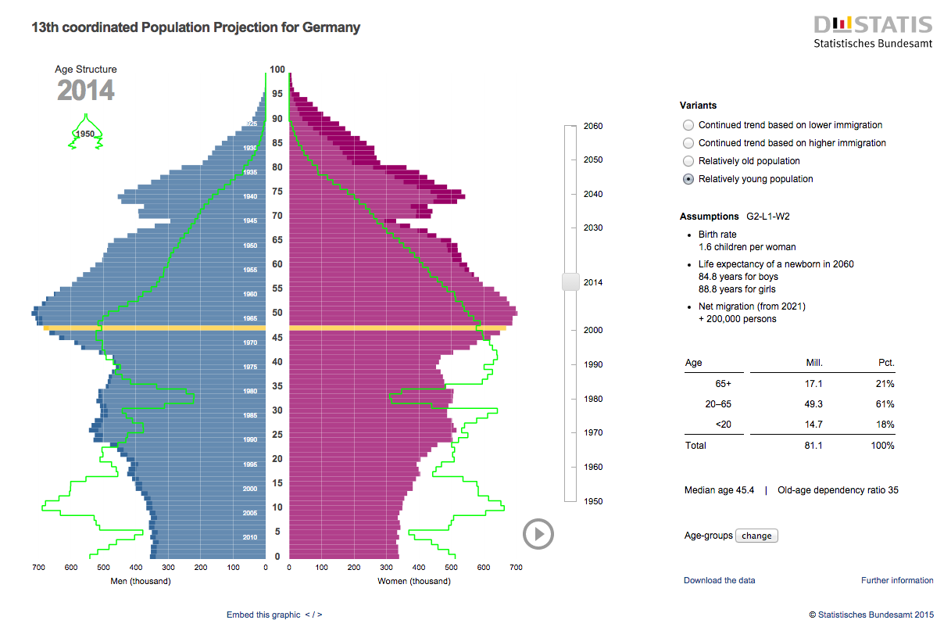

Slide 22
How do you assess information visualization?
Very carefully

Slide 23
How do you assess information visualization?

